Slide 1
MICROCONTROLLER AND INTERFACING
(22EC104013)

Slide 2
UNIT-1 INTRODUCTION TO MICROCONTROLLERS
Syllabus:
Major components of a computer system
Role of CPU
Major components & purpose
Microprocessor Vs Microcontrollers
Concept of Embedded systems
Criterion for considering a Microcontroller

Slide 3
Text Books & References
Kenneth J. Ayala, The 8051 Microcontroller-Architecture, Programming & Applications, 3 rd Edition, Cengage learning, June 2007.
Muhammad Ali Mazidi and Janice Gillespie Mazidi and Rollin D, The 8051 Microcontroller and Embedded Systems-using assembly and C, PHI, 2006/ Pearson New International Edition 2014.

Slide 4
Basic concepts

Slide 5
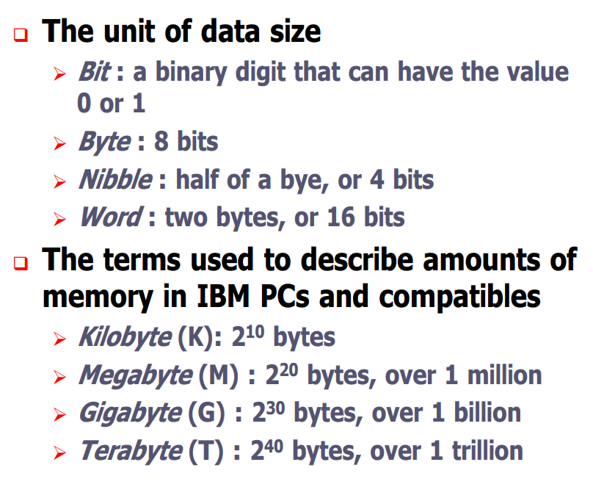
Important Terminologies

Slide 6
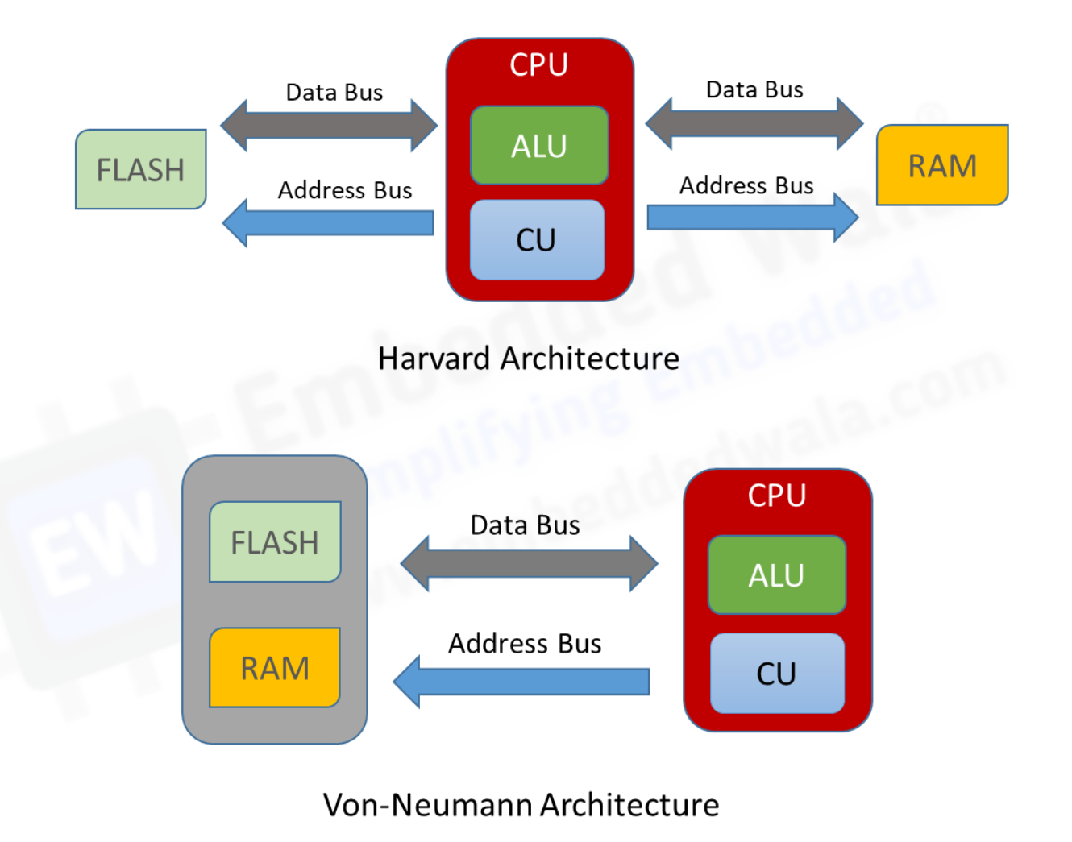
Harvard Architecture Vs Von-Neumann Architecture

Slide 7
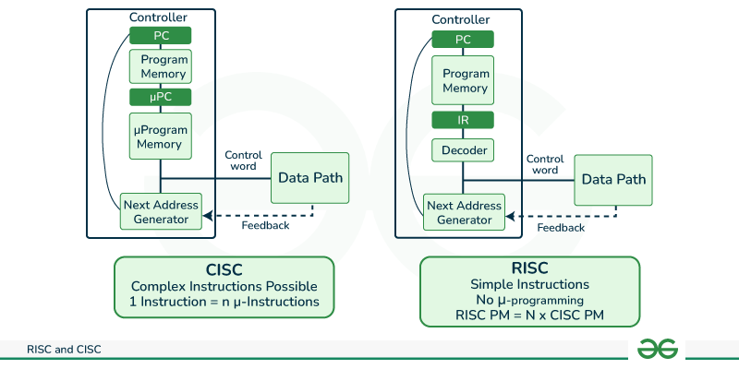
RISC Vs CISC

Slide 8
TOPICS

Slide 9
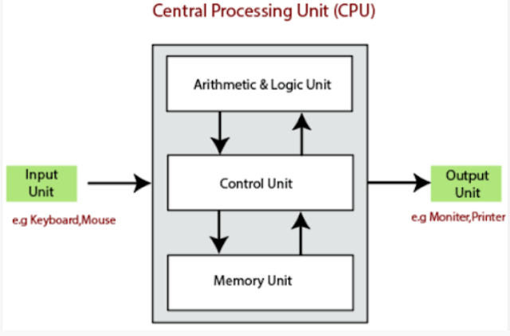
Major components of a computer system

Slide 10
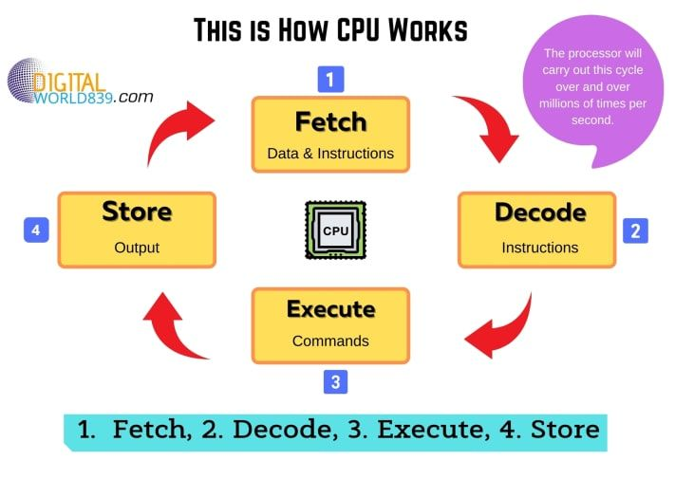
Role of CPU

Slide 11
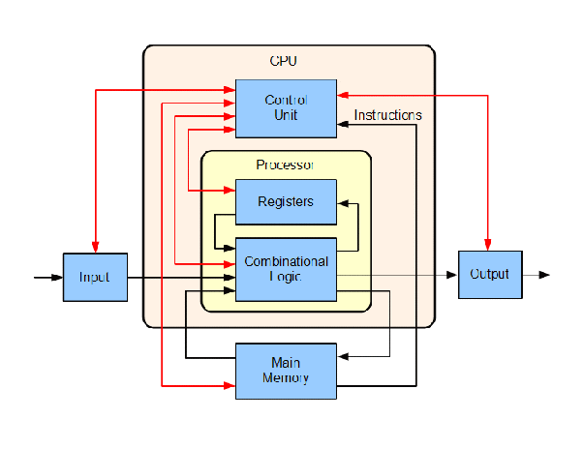
contd.,

Slide 12
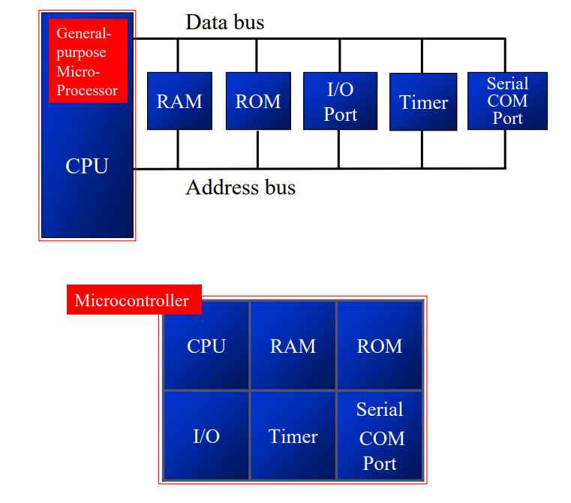
Microprocessors Vs Microcontrollers

Slide 13
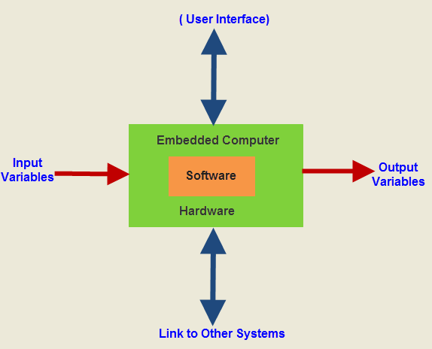
Concept of Embedded System

Slide 14
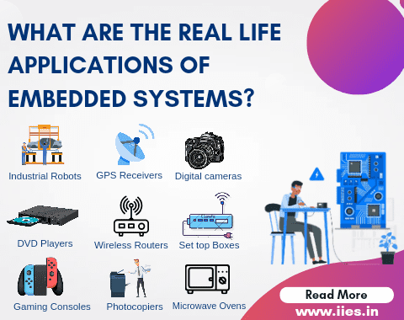
Contd.,

Slide 15
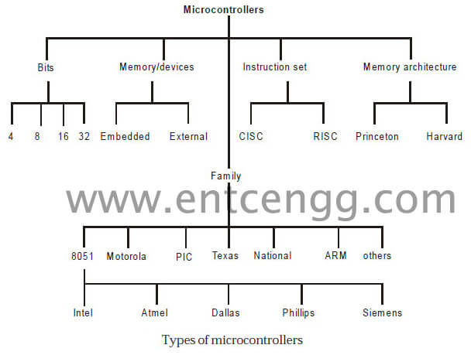
Criterion for choosing a microcontroller

Slide 16
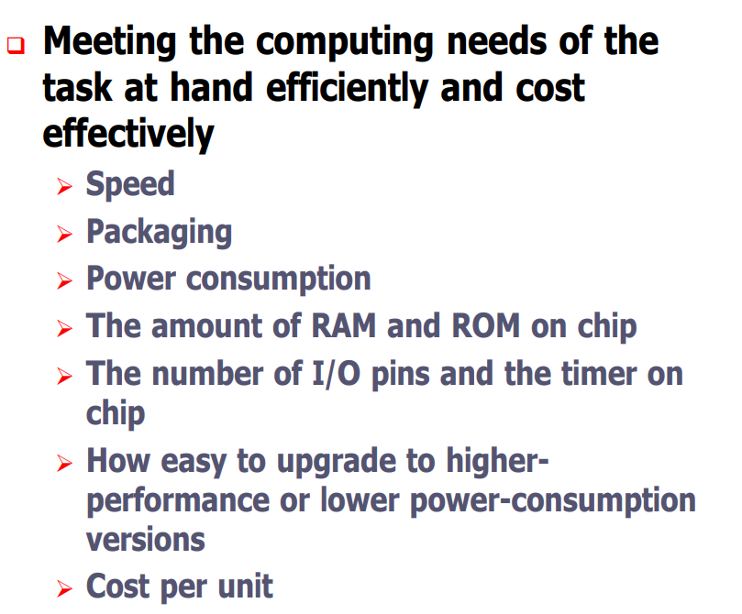
Contd.,

Slide 17
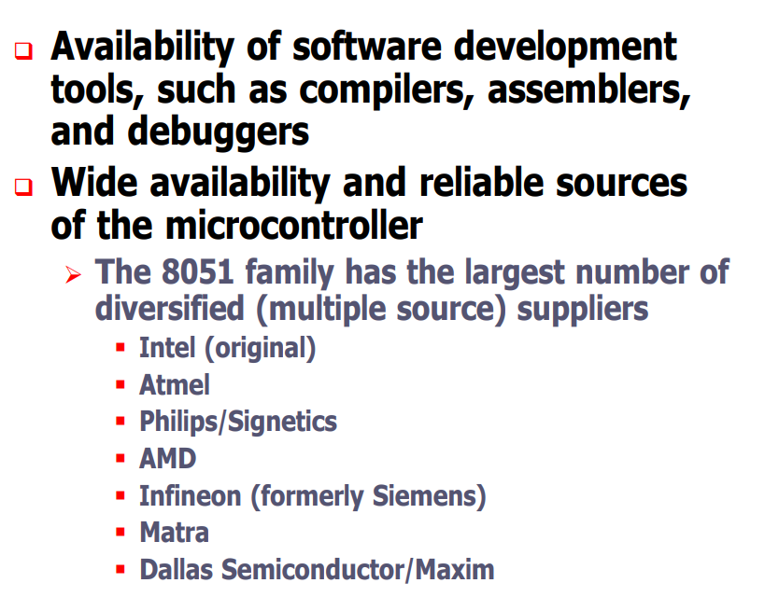
Contd..

